Slide 1
What if free will is NOT an illusion AND can be reconciled with the known laws of physics?
“…Mind is already inherent in every electron, and the processes of human consciousness differ only in degree but not in kind from the processes of choice between quantum states which we call ‘chance’ when they are made by electrons.” – Freeman Dyson, Physicist
by
I, Quantum
www.eyequantum.com

Slide 2
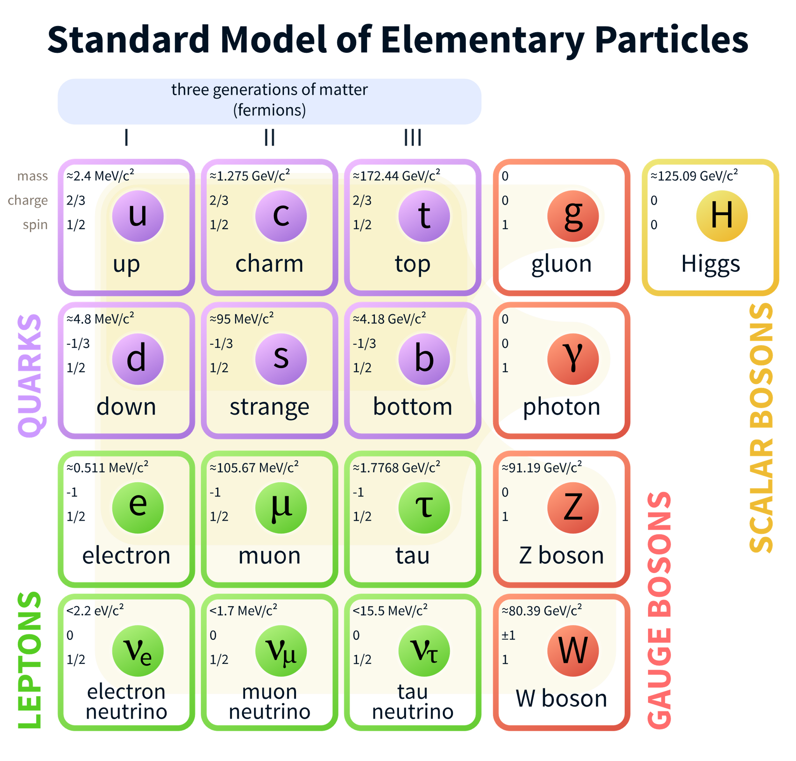
The Case Against Free Will:
Experiments of Libet et. al. from the 1980’s show readiness potentials (RP) in the brain can predict action a few hundred milliseconds prior
Moran Cerf TEDx video “Free Won’t” (2015)
Fried et. al. (2010) – readings of individual neurons
Soone et. al. (2008) – brain imagining
Reductionist view extremely simple & successful
Pyramid where physics is the foundation on which chemistry, and then biology are built. Quantum effects tend to wash out as random noise, leaving determinism at the level of biological systems. Qualia of life “emerge” somehow from complex biological interactions but are not fundamental.
The Standard Model of elementary particles (more schematic depiction), with the three generations of matter, gauge bosons in the fourth column, and the Higgs boson in the fifth By MissMJ - Own work by uploader, PBS NOVA [1], Fermilab, Office of Science, United States Department of Energy, Particle Data Group, Public Domain via Wikipedia

Slide 3
Despite Results in Neuroscience and Success of Reductionist View
Free will does not feel like an illusion!
Objective explanation feels “incomplete”. Where does the 1st person perspective come from?
If it emerges from a sort of neural network, at what point does the proverbial “light” suddenly go on? If we take away one neuron, is the system suddenly lifeless? This seems completely arbitrary!
Science cannot account for the qualia of life’s experiences.
“In this chapter I have tried by simple examples, taken from the humblest of sciences, namely physics, to contrast the two general facts (a) that all scientific knowledge is based on sense perception, and (b) that none the less the scientific views of natural processes formed in this way lack all sensual qualities and therefore cannot account for the latter”. – Erwin Schrödinger, What is Life? (1944)
Can we supplement the objective description of science? What if we could reconcile the 1st person subjective viewpoint with the 3rd person objective description as dual views of the same thing?
No new forces, no new particles

Slide 4
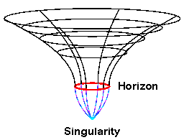
Dualities
NOT talking about Descartes’ Mind-Body Dualism
Linear programming primal vs. dual
The theory of relativity
AdS/CFT duality
1st person vs 3rd person experience – the “Hard problem” of consciousness
Black hole diagram showing event horizon and singularity at the center – the subject of the AdS/CFT duality from UCSD Center for Astrophysics and Space Sciences

Slide 5
Let’s first get the quantum measurement problem out of the way…
No wave function collapse, quantum evolution is always smooth, unitary, time reversible. No need for MANY WORLDS!

Slide 6
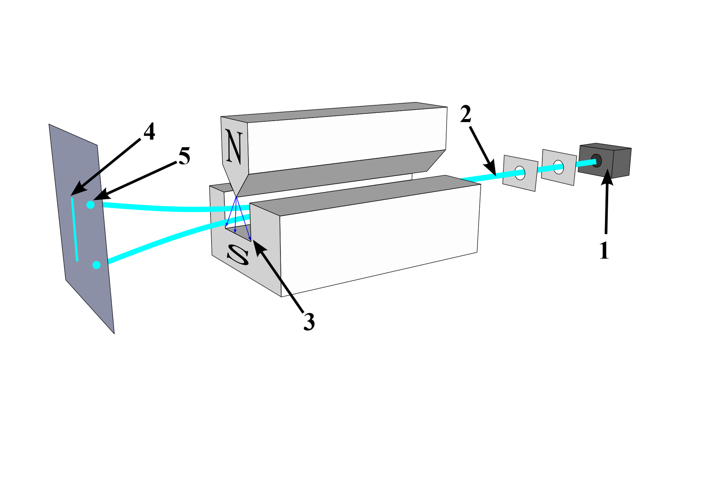
The Stern-Gerlach Experiment
The Stern-Gerlach experiment (1922) proved that spin was quantized
Each silver atom has spin = +1/2 or -1/2
Stern–Gerlach experiment: silver atoms travel through an inhomogeneous magnetic field and are deflected up or down depending on their spin. 1: furnace. 2: beam of silver atoms. 3: inhomogeneous magnetic field. 4: expected result. 5: what was actually observed. Image and caption by Tatoute at Wikipedia.

Slide 7
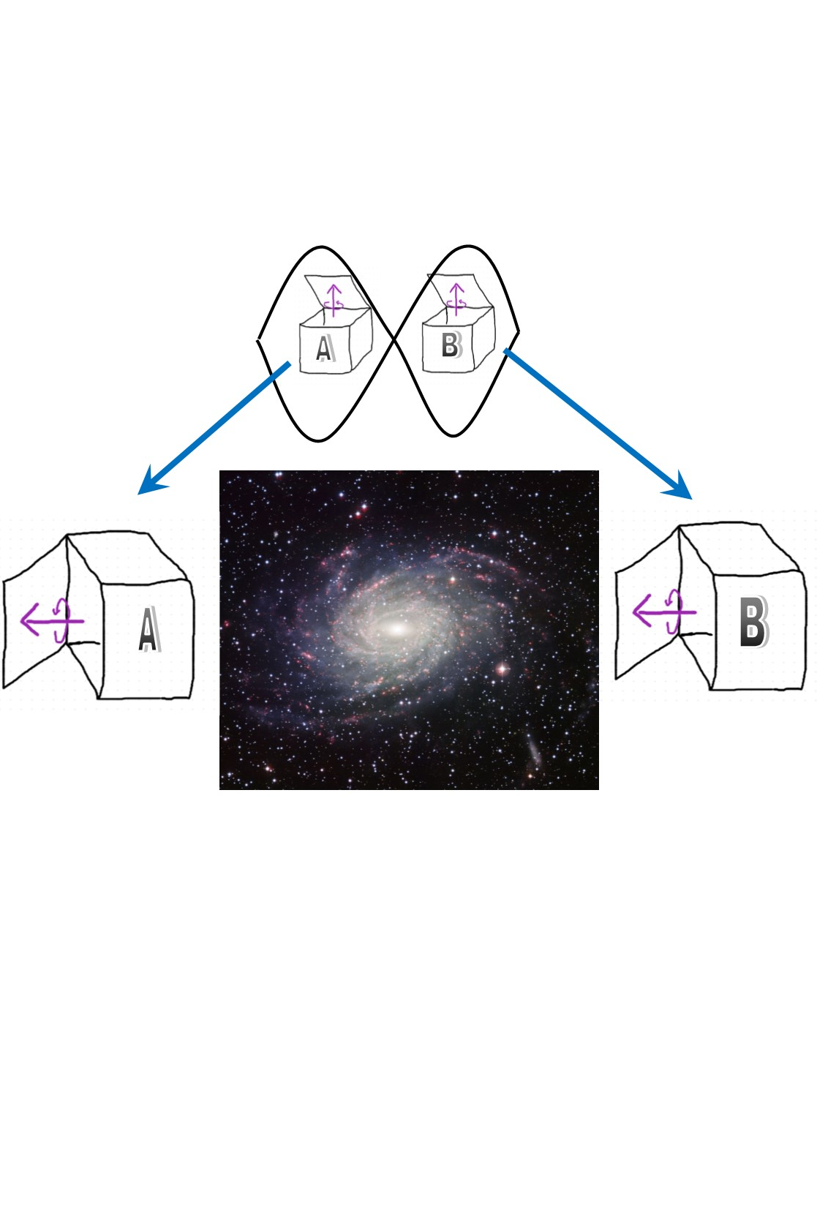
Quantum Entanglement
Only way to take two or more particles and make them into One system of particles in a meaningful way
No theoretical limit on how extensive entanglement may be - billions of particles have been experimentally entangled in the lab
Two entangled electrons placed into two boxes through the top, separated by a galaxy, then opened on the side (or any side for that matter), will always be found spinning in the same direction -it could be either left or right, but A and B will always point the same way. Picture of Milky Way Galaxy here.

Slide 8
Suppose Dyson is correct and the electron does make a choice
Quantum probabilities in the 3rd person objective description are dual to preferences in the 1st person
Measurement is dual to choice
But, much is still missing from this electron’s subjective experience –no memory, choice forced upon it, no understanding, no self-awareness, no expectations of the future, nothing like human consciousness
$$ψ_{Initial}=\frac{1}{\sqrt{2}}\left.|UP\right\rangle +\frac{1}{\sqrt{2}}|\left.DOWN\right\rangle$$

Slide 9
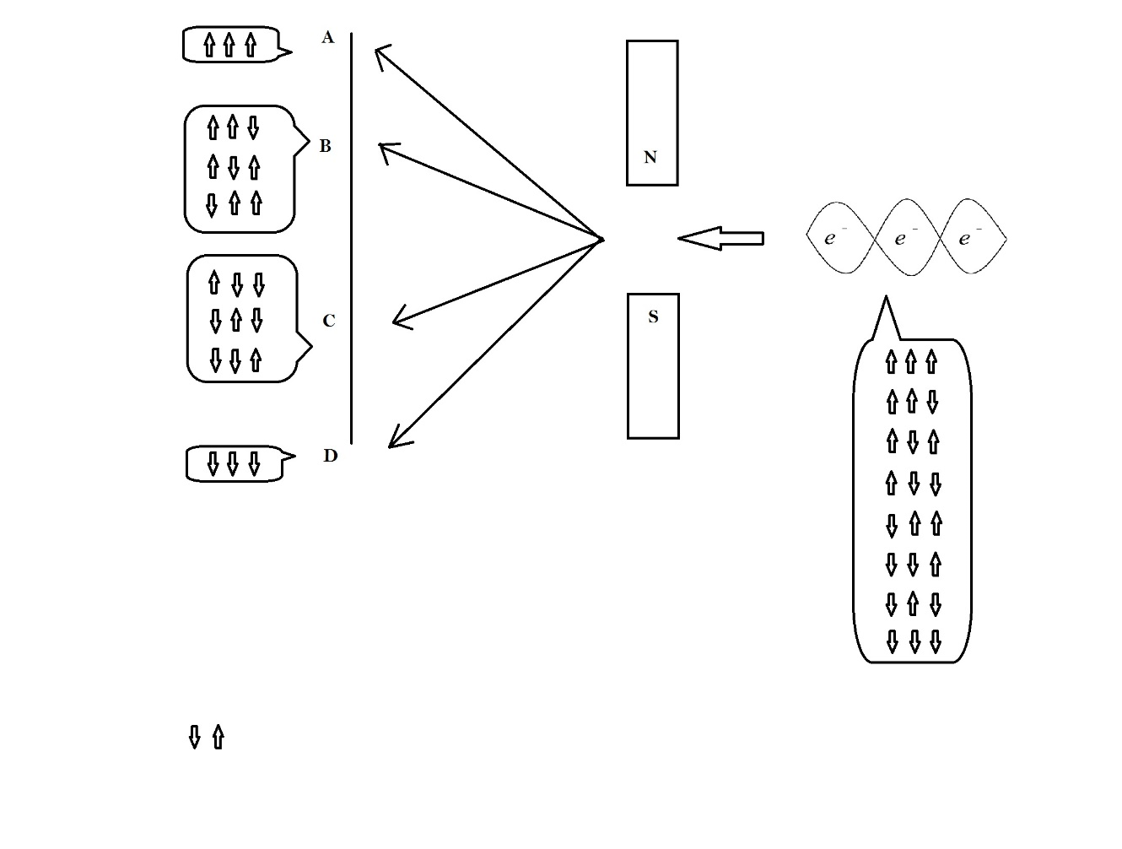
With a packet of 3 entangled electrons some interesting things begin to happen:
System is still entangled, still in superposition after measurement – still ONE thing, quantum computing power still accessible
System is left in an eigenstate –basic memory
But, choice still forced upon it, nothing like our free will yet
$ψ_{Initial}=\frac{1}{\sqrt{8}}$($\left.|UUU\right\rangle +|\left.UUD\right\rangle$+$|\left.UDU\right\rangle$ +$|\left.UDD\right\rangle$ +$|\left.DUU\right\rangle$ +$|\left.DDU\right\rangle$ +$|\left.DUD\right\rangle$ +$|\left.DDD\right\rangle$)
where U=spin up, D=spin down

Slide 10
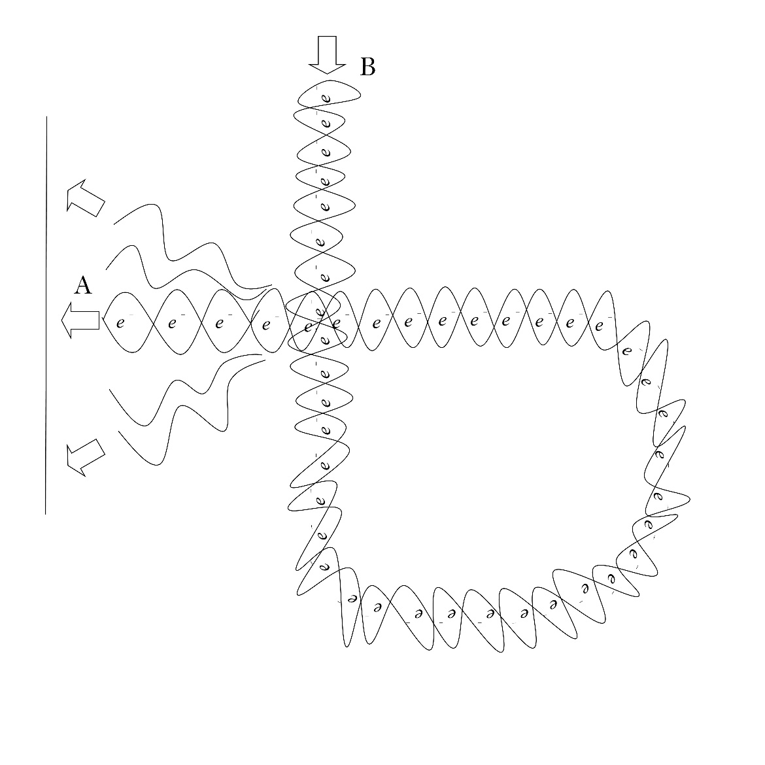
Crisscross Entanglement
All of the properties of the 3 electron case still hold, like memory, quantum superposition, one system
System interacts with itself allowing end “B” to affect where end “A” is directed – a nonlinear interaction
The system acts as its own Stern-Gerlach magnet!

Slide 11
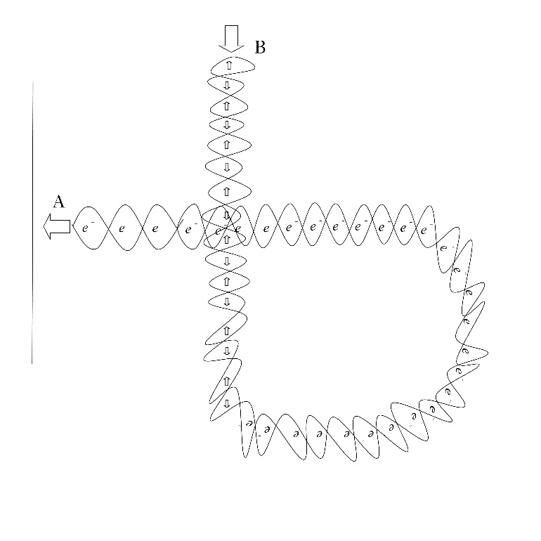
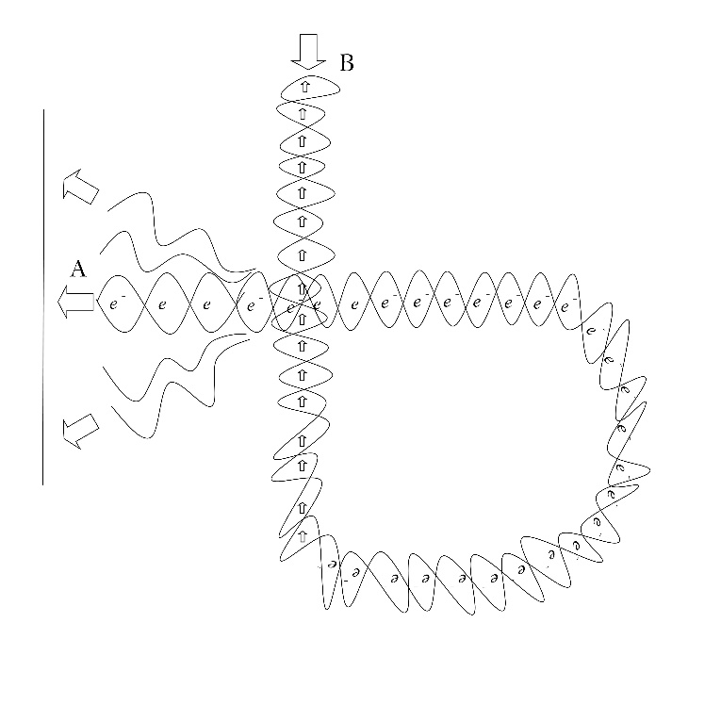
Choosing to make a choice or not
Choose spins all up at end “B” means replicate the Stern-Gerlach apparatus, choose to measure (1st)/make choice (3rd)
Choose spins mixed at end “B” means no magnetic field for end “A” – no measurement (1st)/choice (3rd)

Slide 12
Free Will by Rush (1980)
“You can choose a ready guide
In some celestial voice
If you choose not to decide
You still have made a choice
You can choose from phantom fears
And kindness that can kill
I will choose a path that’s clear
I will choose free will.”
– the song Free Will by Rush (1980)

Slide 13
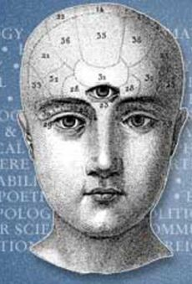
The Mind’s Eye
What if this collection of entangled particles is YOUR MIND?!?
One system in 3rd person quantum mechanical terms is dual to your feeling of Oneness in the 1st person
You can choose to make a choice or not
You have the power of a quantum superposition for hard problem solving/creativity
Your choices are constrained by quantum probabilities – that is, by your own preferences
By choosing where to make choices, you can direct your thoughts – this feels like our mind’s eye
Artist’s illustration of the mind’s eye. The focus of our thoughts can feel like a third eye. From Psychology Today here.

Slide 14
“Going out to dinner” Gedänken experiment
Suppose somewhere in your brain there is a “button”, that, if pressed, will start in motion the process of going out to dinner
Suppose, you are “on the fence”, that is, you feel 50%/50% about it
That means that the projection of you onto that button has a quantum probability of 50%
Thinking about it, is like a weak measurement. When you push the button, that is a strong measurement of your self – a choice.

Slide 15
Is this really free will?
Descartes said “the will is by its nature so free that it can never be constrained”
But, I am constrained probabilistically by my preferences:
Hard to zap myself in the eye with a laser pointer
Very difficult to resist chocolate! ☺
Can you game the system? This changes the game, no longer thinking about the “go out for dinner button”, but rather, the “game the system button”

Slide 16
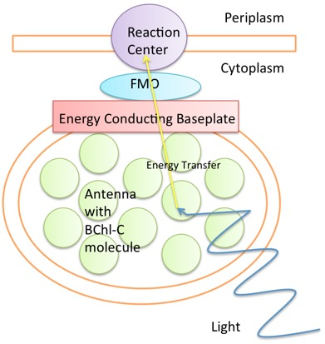
How could extensive quantum entanglement manifest in biological systems
The challenge is decoherence is fast – picosecond fast (in photosynthesis)
Neurons are too big – Tegmark (1999)
But, entanglement can be sustained if it is refreshed faster than decoherence
And, biomolecules are natively vibrating at very fast rates – nanoseconds to femtoseconds!
“Persistent Dynamic Entanglement from Classical Motion: How Bio-Molecular Machines can Generate Nontrivial Quantum States” by G. G. Guerreschi, J. Cai, S. Popescu, and H.J. Briegel (2012)
“Dynamic entanglement in oscillating molecules and potential biological implications” by J. Cai, S. Popescu, and H.J. Briegel (2010)
“Generation and propagation of entanglement in driven coupled-qubit systems” by J. Li and G.S. Paraoanu (2010)
“Steady-state entanglement in open and noisy quantum systems” by L. Hartmann, W. Dür, and H.J. Briegel (2005).
Quantum biology – photosynthesis. Diagram of the FMO complex. Light excites electrons in an antenna. The quantum exciton then transfers through various proteins in the FMO complex to the reaction center to further photosynthesis. by By OMM93 - Own work, CC BY-SA 4.0 via Wikipedia

Slide 17
Helical Structures (e.g. alpha-helix) give rise to nonlinear interactions and are ubiquitous in biology
Alpha-helix (Davydov soliton)
Tubulin (microtubules)
Ion channels
DNA
RNA
Image of the alpha-helix structure ubiquitous in biological systems. Helical structures give rise to nonlinear Hamiltonians which, in turn, imply the Nonlinear Schrödinger equation. This has quasiparticle solutions – like the Davydov soliton that transports energy along the alpha-helix. The nonlinear Hamiltonian arises from transverse quantum states entangling with longitudinal phonon states. This nonlinearity of entangled particles (in the 3rd person description) is dual to the mind’s eye (in the 1st person, subjective description). This image is from here, image from Voet, Voet & Pratt 2013, Figure 6.7

Slide 18
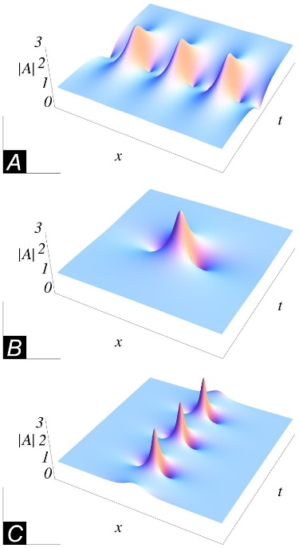
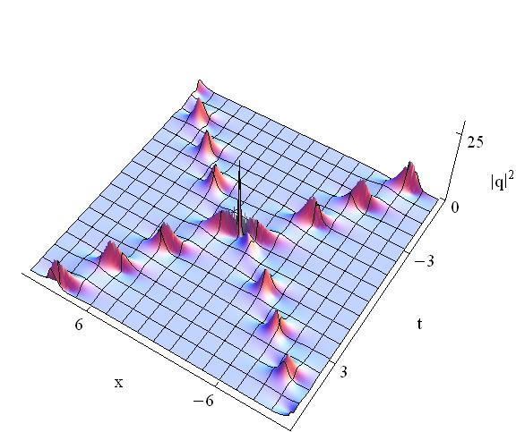
Nonlinear Schrödinger Equation Appears in Biological Systems
Examples of known solutions to the NLSE in biological systems (quasiparticle solutions):
Davydov solitons
Fröhlich condensates
Many more…
If time dependence also non-linear, can solve NP-complete problems in polynomial time
Other non-biological instance
Bose-Einstein condensates
Superfluid Helium – Angulons
Top: Davydov Solitons from Wikipedia, Bottom: “Breather interactions” from EPJ.org

Slide 19
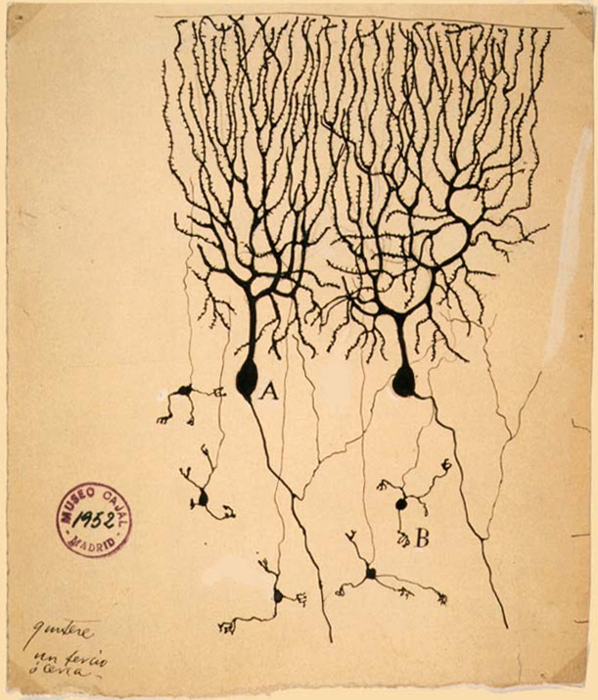
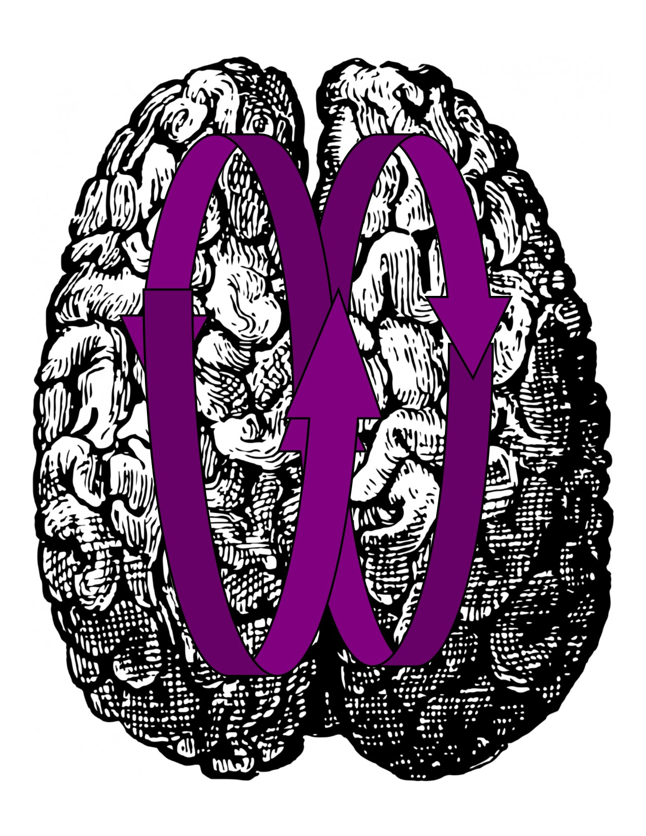
Does this description agree with results from biology and neuroscience? – Yes!
Patients can willfully override the RP and cancel predicted action
Suggest something else is going on besides neurons
Short-term (quantum) vs long-term (neurons) memory
Highway Hypnosis
Evidence shows deliberate, self-initiated randomized behavior in animals & the mind’s eye of the fly (random to us could be choice to them)
Top-down reasoning & CAPTCHA (Completely Automated Public Turing Test to tell Computers and Humans Apart)
R.W. Sperry’s “split brain” experiments
Evidence shows a speed of free will of 100-200 millisec (the time to press a “button”)
“The Brain is the keyboard of the mind” – Alan Wallace

Slide 20
You can willfully override the RP with your mind!
“Point of No Return in Vetoing Self-Initiated Movements” by J. Haynes, B. Blankertz, and M. Schultze-Kraft
Patients played a game again a computer interfaced to read their EEG activity real time.
Results showed you can willfully override the RP and outdo prediction by the computer up to a point just before action
Maybe this is focusing yourself onto the “game button”, making a weak measurement of yourself ,causing a buildup in the readiness potential (RP). But, playing the game recursively affects your preferences, your quantum probabilities, causing you to randomize your behavior and override the RP.
All of this is consistent with Buddhist scholar Alan Wallace description of the brain as the “keyboard of the mind”

Slide 21
Speed of Free Will
In a paper entitled “The Speed of Free Will” by T. Horowitz, J. Wolfe, et. al. the authors compare the time required for subjects to voluntarily shift their attention, versus stimulus driven shifts.
The former tend to take about 100-200 milliseconds longer suggesting a speed of free will
This may be the time it takes to focus your mind’s eye, press a “button” and initiate action

Slide 22
Short-term vs. Long-term Memory
Short term typically lasts for about 18-30 seconds, while long term last much longer - such as the life of the organism
One reason for the distinction: patients suffering from anterograde amnesia can form short term memories but not long term ones
Also, certain types of “distraction tasks” can affect one form of memory but not the other
Hebbian principles say that neurons that “fire together wire together”
Could a quantum ticker-tape of information (e.g. solitons) being flowing through the brain? Since it is in an eigenstate it would flow through the same channels again, and again transferring short-term quantum memory to long-term memory in neuron connections.
Evidence shows even patients with amnesia can form long term memories if they can keep short-term ones “in mind” - in “Delaying Interference Enhances Memory Consolidation in Amnesic Patients” by M. Dewar et. al. (2010)
Need a way to entangle neighboring helical biomolecules – no theoretical approach yet!

Slide 23
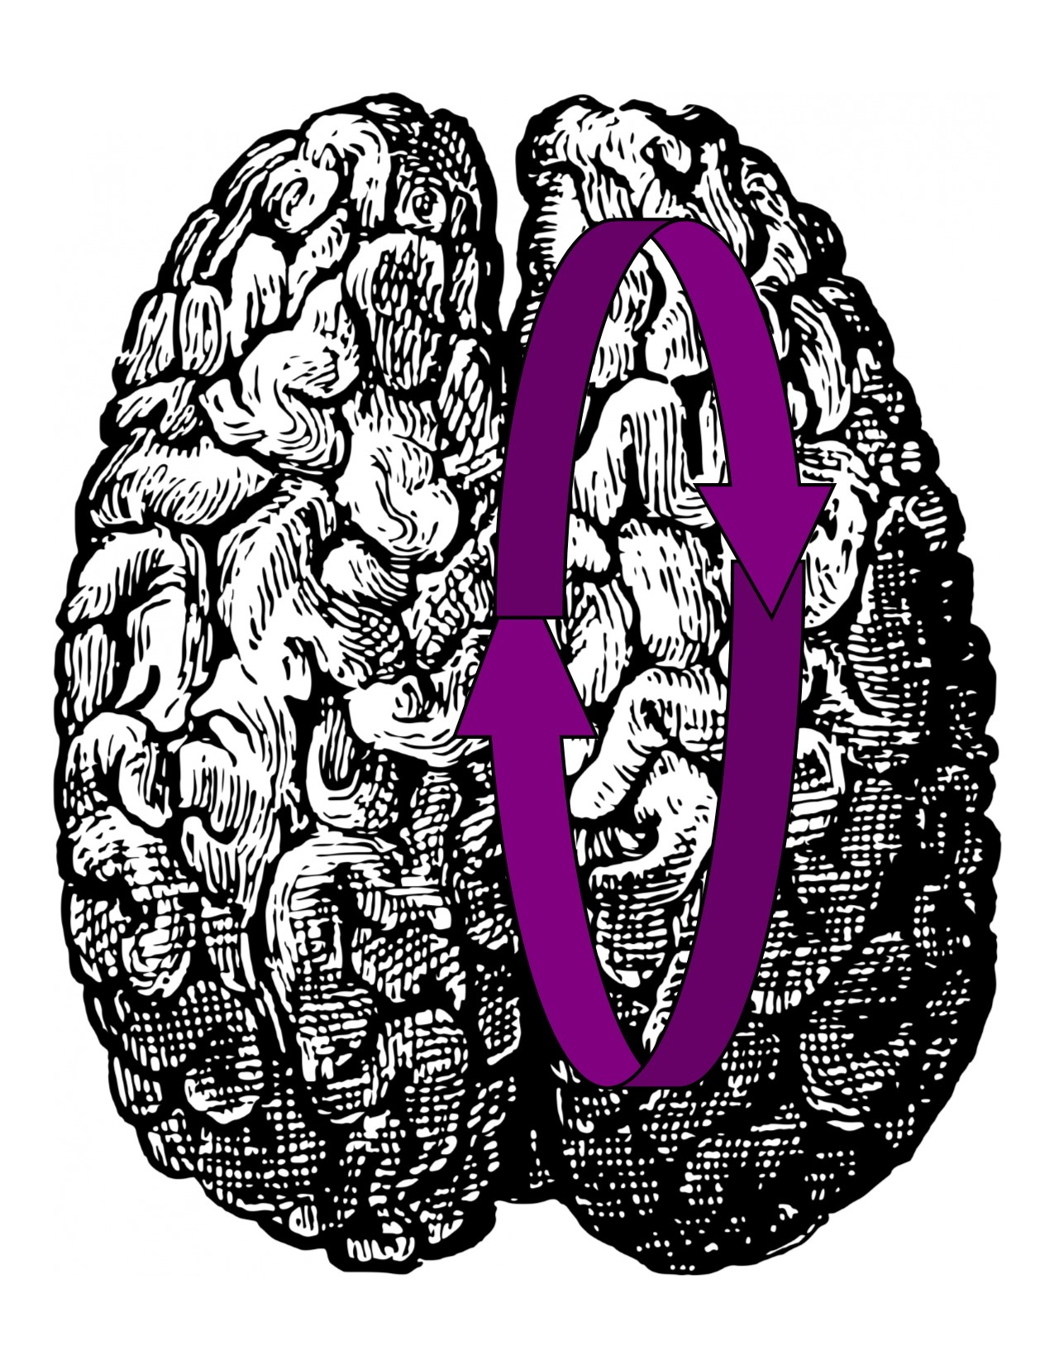
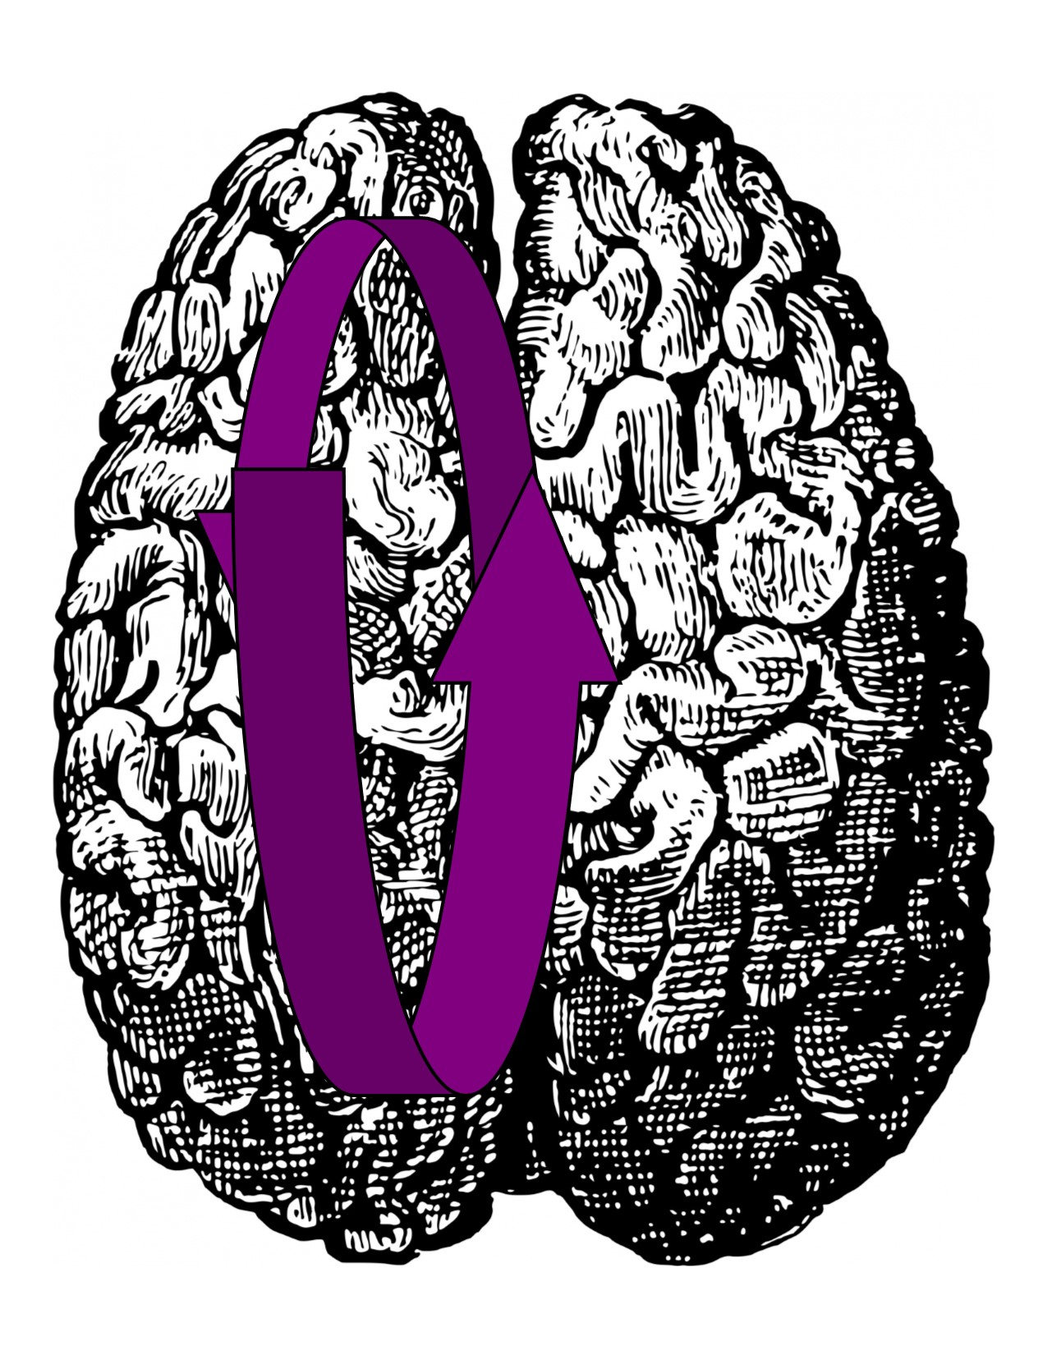
Sperry’s Split Brain Experiments (1964)
Corpus Callosum connects the two hemispheres of the brain
Surgically severed to halt epileptic seizures in patients
R. Sperry observed that “it was thought each hemisphere were a separate mental domain operating with complete disregard- indeed, a complete lack of awareness – of what went on in the other”
Corpus Callosum “had the important function of allowing the two hemispheres to share learning and memory”
You may have felt your dominant eye when aiming a bow and arrow

Slide 24
Highway Hypnosis

Slide 25
Top-Down Reasoning
Computers and humans have similar visual recognition ability when only given a split second to look at an image
But, on difficult images, like this CAPTCHA, people can invoke top-down reason which machines cannot replicate
Is top-down reasoning invoking the mind’s eye, the quantum self to solve these recognition problems?

Slide 26
Free Will in Animal Species
In “Toward a scientific concept of free will as a biological trait: spontaneous actions and decision-making in invertebrates” by B. Brembs (2010):
Animal behavior is self-initiated: different responses even though the environment is the same
“A neuronal amplification process has been directly observed in the barrel cortex of rodents.” – Noise? Or, the choices of a quantum entangled system?
“Flies can actively shift their focus of attention restricting behavioral responses to parts of the visual field”

Slide 27
So, what do we have?
A compelling story where we assume a 1st person perspective in fundamental particles and that quantum probabilities in the 3rd person are dual to preferences in the 1st:
From that, we get:
The natural emergence of short-term, quantum memory
An idea of what the Mind’s eye is and where it came from
A source for our feeling of Oneness
A hint of where life’s ability to solve hard problem’s comes from (quantum computing)
Free will
But, we can get more:
Quantum only cares about energy states
Lower and/or more stable energy states are preferred – dual to quantum transition probabilities (e.g. electrons in higher energy orbitals quickly emit photons and return to the ground state)
Pleasant feelings of Meditation, Sex, Understanding all have to do with quantum probabilities favoring lower/more stable energy states

Slide 28
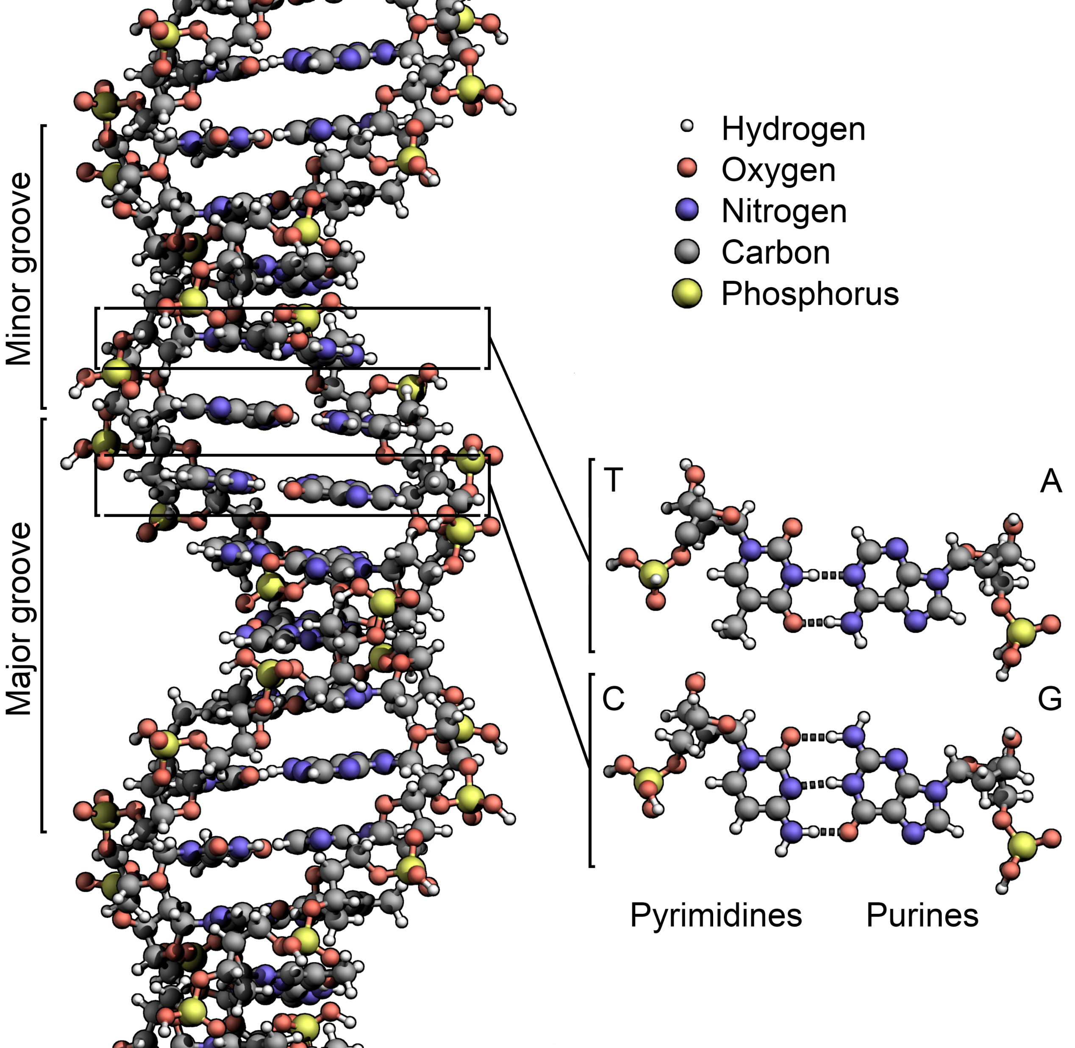
Quantum Entanglement binds DNA together
E. Rieper et. al. (2010)
Electrons enter a superposition of states to stabilize the molecule
Not a new trick of nature – nucleus of deuterium
Suppose we could extend this throughout the organism – a living quantum network. How?
The structure of the DNA double helix. The atoms in the structure are colour-coded by element and the detailed structure of two base pairs (nucleotides) are shown in the bottom right. The nucleotides are planar molecules primarily aligned perpendicular to the direction of the helix. From Wikipedia.

Slide 29
The Good, the Bad, and the Dual
All of this paints a picture of the evolution of life as synonymous with growing quantum entanglement – a sense of Oneness is always there, choices is always there, but at a certain point entanglement is sufficiently extensive that memory emerges, then crisscross entanglement leading to a mind’s eye
We’ve talked about where preferences come from - dual to quantum probabilities
But, what about good and bad? Why should anything feel pleasant or unpleasant? (Stress, Meditation, Sex, Understanding, Love, Qualia)

Slide 30
How might a quantum network be possible in an organism?
Need to refresh it dynamically in timeframes faster than decoherence (picoseconds)
DNA, though, can down convert photons in femtoseconds – a kind of antennae
DNA may function as a coherent EPR source of THz photons
“Observation of coherent delocalized phonon-like modes in DNA under physiological conditions” (using a THz laser) by M. González-Jiménez et. al. (2016)
A diagram of a quantum network from Centre for Quantum Computation & Communication Technology. EPR sources at either end are sources of entangled qubits where A&B and C&D are entangled. The joint measurement of B & C occurs at the quantum repeater in the middle entangling A & D at a distance.

Slide 31
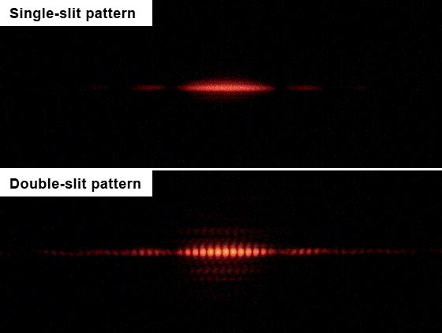
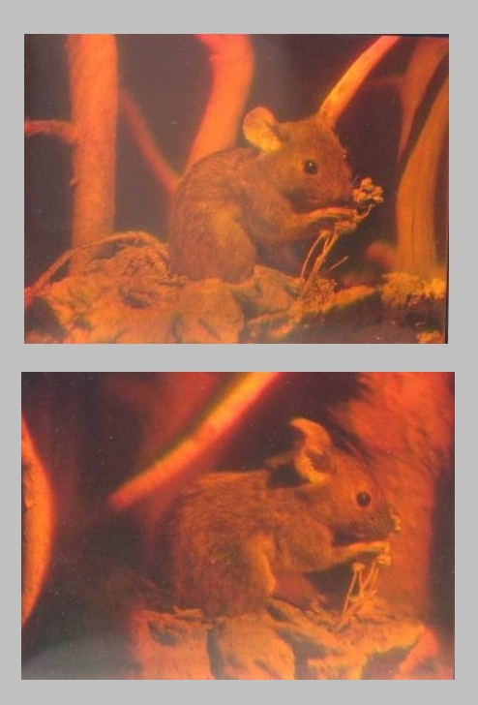
What is stress?
Two-slit interferometer experiments must be performed in a vacuum, gas molecules disturb & destroy the interference pattern
Instead of a planar simple interference pattern, imagine a 3-D hologram in the organism. Not a visual hologram, but perhaps in the THz range.
Any disruption to the hologram disrupts the stabilizing entanglement energy in the organism
When the hologram is disrupted, for whatever reason, this is a stress. You feel this as stress.
Adapting to stress is clearing up the interference pattern
Left: A hologram of a mouse. Two photographs of a single hologram taken from different viewpoints by By Holo-Mouse.jpg: Georg-Johann Layderivative work: Epzcaw (talk) - Holo-Mouse.jpg, Public Domain from Wikipedia, Right: Results from the Double slit experiment: Pattern from a single slit vs. a double slit.By Jordgette (Own work) [CC BY-SA 3.0

Slide 32
Meditation
Zeno’s paradox refers to the quantum phenomenon of continually observing something, measuring it. This keeps it localized.
Meditation is the opposite. It is not measuring yourself. The pleasantness of meditation is allowing quantum entanglement to grow, to allow stabilizing quantum entanglement to achieve a more stable energy state for you, the organism
Intuitively, think of biomolecules throughout ourselves operating coherently, synchronized, like a marching band functioning as One
Pic from here: http://floweringheart.org/Man-Meditating.jpg

Slide 33
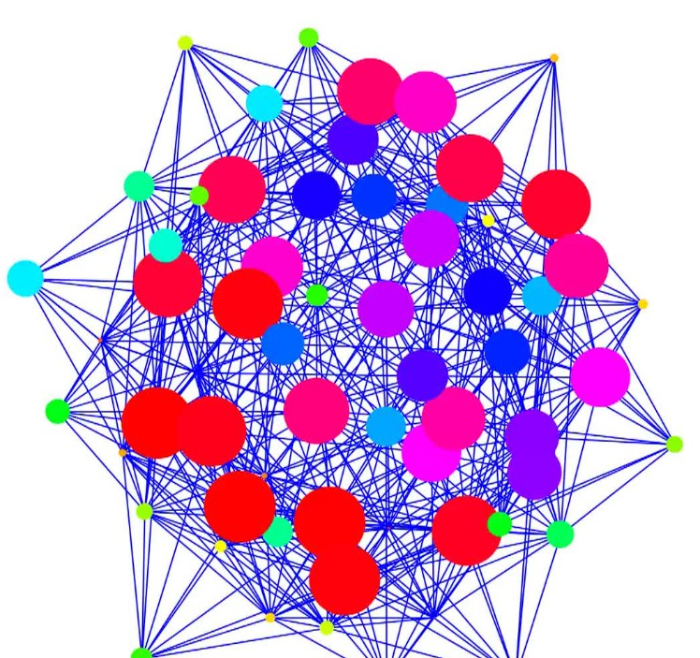
Positive/Negative Feelings Correspond to Energy States
Sex
May create an especially low energy state called a Fröhlich condensate, requires a driving motion to put energy into it
Understanding
The “Aha!” moment, when we get something, is the transition of a quantum neural network (like an Ising Spin Glass model) to a lower energy state
Doing the “right” thing is about choosing long-term stable energy states
Discipline in the mind’s eye, focus on the straight and narrow path
Vice is choosing short-term energy states that are easily accessible but are unstable
Another nonlinear Schrödinger equation (NLSE) solution – the Helmholtz Hamiltonian system. Definitely watch the video and get more information from Quantum Calculus.

Slide 34
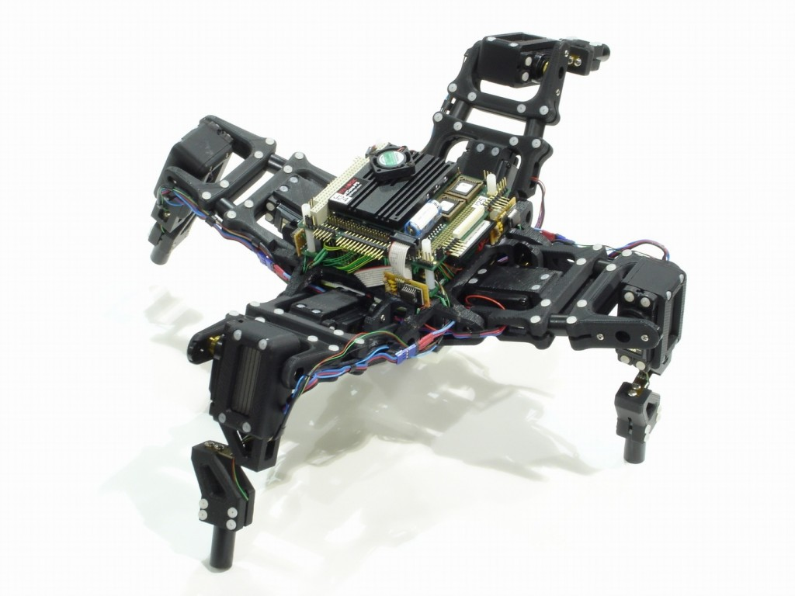
Self-Awareness
Hod Lipson’s “self-aware robots”
TED Talk Video here
Two modules: one model that learns what the robot looks like (e.g. number of legs, number of joints, location of them, etc.), and a second that uses this model for locomotion
The two modules operate serially, in sequence
Very amazing, but not really self-aware. Modules are processed by a CPU with no awareness of what it is really doing
Real self-awareness derives from having the modules entangled together as one unit, so the robot functions as One thing

Slide 35
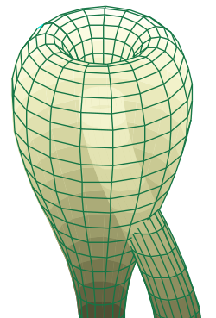
Gödel’s Incompleteness Theorem
There are mathematical statements that cannot be resolved in formal mathematical systems, like:
“This statement is false”
Three Quantum properties distinguish quantum systems from classical (and formal) systems:
The ability to self-reference as exhibited by crisscross entanglement
Quantum systems can be in a superposition of true and false at the same time – allowing you to “understand” or “represent” this statement in your mind even though you cannot prove it true or false
The ability to evaluate infinities – Nature evaluates non-local solutions to the Schrodinger equation instantly and all the time (path integrals sample infinitely many possibilities instantly)
[B sure to say why is this critical?]
A two-dimensional representation of the Klein bottle immersed in three-dimensional space. Image and caption via Wikipedia

Slide 36
Qualia of the senses
Why does seeing feel so different than hearing? If all this information is transformed into neuron firings, why not code it all together in one single display of information? Sounds waves operate at 20-20,000 Hz, light on the other hand is measured in trillions of Hz – there would be no confusion as to the source of the signal
Suppose that the neurons capture the classical information – what’s in the world, where it is, what color it is…
…but, quantum information is what you feel. The feeling of seeing something has to do with photon interactions with your quantum entangled self. The feeling of hearing something is what it feels like to have a phonon propagate through you.
Generally, the feeling of the senses are the dual subjective equivalents of quasiparticle interactions.
a flower depicting five-sold symmetry from “Lotsa ‘Spalinin’ 2 Do”

Slide 37
Moral responsibility
The field of quantum cognition explores whether psychological puzzles can be explained assuming quantum effects – see “You’re not irrational your just quantum probabilistic” by ?. Wang (2015)
People appear irrational when the participate in Prisoner’s dilemma simulations, but if quantum entanglement is assumed between the participants, the empirical results agree with models naturally
This could be the objective dual to subjective “empathy”
Question order is another psychological phenomena that is explained naturally assuming quantum effects
From quantum effects like these, the mantra “do unto others as you would have done unto you” is learned. Moral responsibility follows from learning this game of life, coupled with quantum effects.

Slide 38
Love
Something to do with quantum entanglement between organisms (not just humans)
It comes from the heart, and that is not just a metaphor
Unknown. We leave to the reader to discover for themselves
Picture from: cdn1.theodysseyonline.com

Slide 39
Consciousness
All of the above
From: pinterest.com/explore/consciousness/

Slide 40
Predictability
In “The Ghost in the Quantum Turing Machine” (2013) S. Aaronson discusses the relationship between predictability and free will – if a Turing machine can predict your actions then you have no free will
Fair enough, but considering it takes cutting edge supercomputers 100 days to simulating the dynamics of a single small protein for a millisecond (“Supercomputer sets protein folding record” (2010)) simulating an organism is likely beyond all practical reach even on “age of the Universe” time scales
Furthermore, simulations would like diverge so significantly of nonlinear randomness (i.e. the nested choice of the mind’s eye)

Slide 41
What is it like to be an electron?
Electrons make choices a billion times a second
Emit a photon, absorb a photon, spin up, spin down, bounce right, left
But, no memory of past choices, to anticipation of choices to come
No concentration, no focus, no mind’s eye
Choice is forced upon you, so nothing like human free will
No self-awareness, nothing like human consciousness
Absolutely, insanely in the moment!

Slide 42
“Western civilization, it seems to me, stands by two great heritages. One is the scientific spirit of adventure — the adventure into the unknown, an unknown which must be recognized as being unknown in order to be explored; the demand that the unanswerable mysteries of the Universe remain unanswered; the attitude that all is uncertain; to summarize it — the humility of the intellect. The other great heritage is Christian ethics — the basis of action on love, the brotherhood of all men, the value of the individual — the humility of the spirit. These two heritages are logically, thoroughly consistent. But logic is not all; one needs one's heart to follow an idea. If people are going back to religion, what are they going back to? Is the modern church a place to give comfort to a man who doubts God — more, one who disbelieves in God? Is the modern church a place to give comfort and encouragement to the value of such doubts? So far, have we not drawn strength and comfort to maintain the one or the other of these consistent heritages in a way which attacks the values of the other? Is this unavoidable? How can we draw inspiration to support these two pillars of western civilization so that they may stand together in full vigor, mutually unafraid? Is this not the central problem of our time?” – Richard Feynman, physicist
The END
For more, including this PowerPoint, go to I, Quantum
www.eyequantum.com

